Slide 1

Te Whatu Ora (Health NZ) Southern
RN and EN Preceptor Course
2026

Slide 2
Topics of discussion/korerō
Your Role as an RN or EN preceptor – acknowledgement of extra workload
Expectations of the School of Nursing / Clinical Lecturers / Student concerns
Effective preceptor feedback
  Oral and written feedback
Support as an RN or EN Preceptor
  School of Nursing
  NZNO guideline principles of Manaakitanga, Whanaungatanga and Kotahitanga
  Nursing Council delegation changes - Responsibilities for direction and delegation of care to enrolled nurse
  Nurse Educator/Charge nurse
  Enrol in online preceptor Moodle course here

Slide 3

Common student concerns
Will I fit in?
How will they treat me?
Will anyone want to preceptor me?
Will I get on with my Preceptor?
What is the culture like?
What could we add to this list?

Slide 4
Student placement structure (2026)
BNY1
  1 x 64hr hospital placement in Oct-Nov (across 6 weeks)
BNY2
  1 x 200hr acute care placement
  1 x 160hr community placement
BNY3
  3 x 120hr placements – acute care, mental health & community health (project)
  360 hours transition placement
ENY1
  Starts in Semester 2 2026 – theory only
ENY2
  1 x 200 hr acute care
  1 x 200 hr mental health & addictions

Slide 5
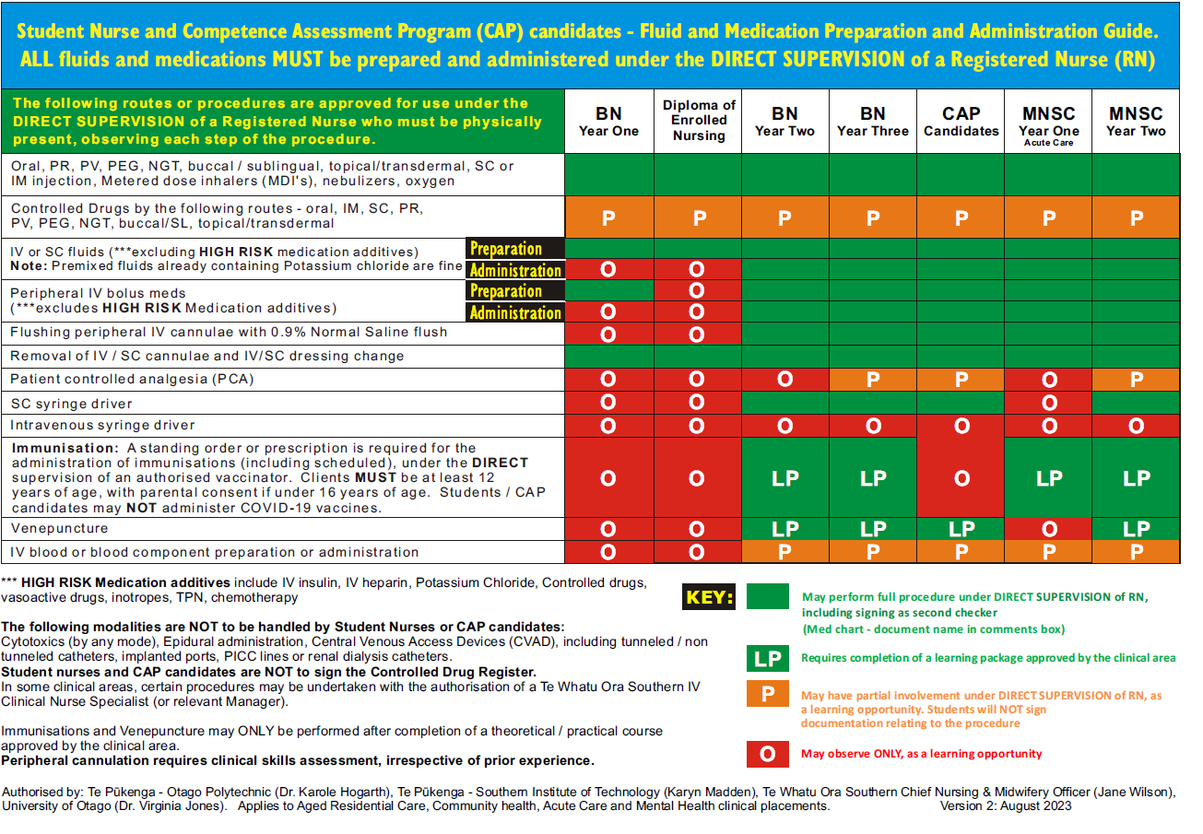

Slide 6

February 2025 – New NCNZ RN and EN standards of competence introduced
Student documentation now aligns with the 6 Pou for RNs and 5 Pou for ENs
EN standards of competence: here
RN standards of competence: here

Slide 7


Slide 8


Slide 9
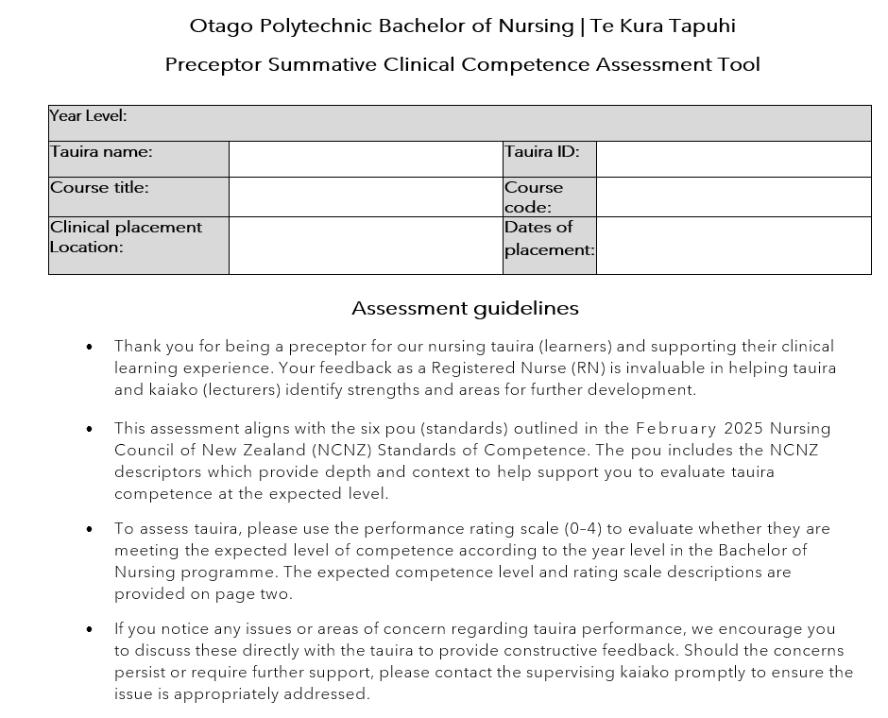
Preceptor feedback

Slide 10
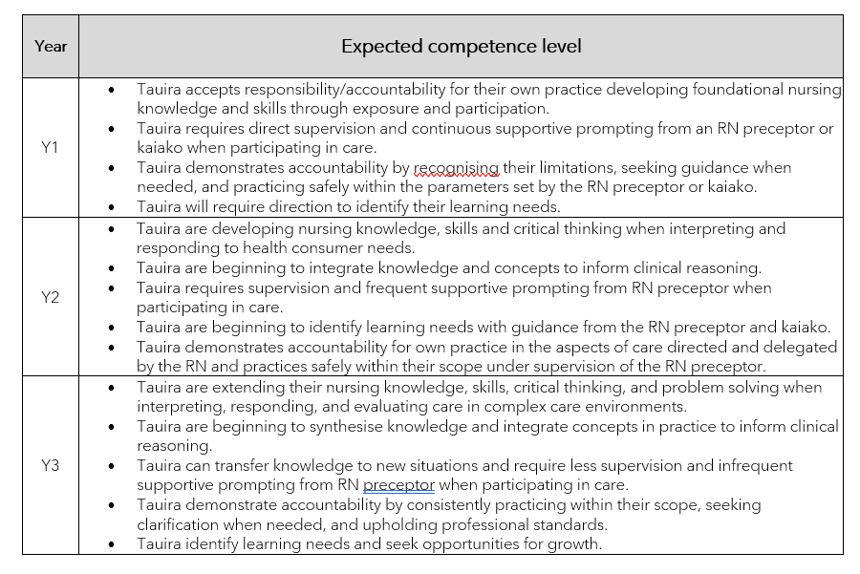

Slide 11
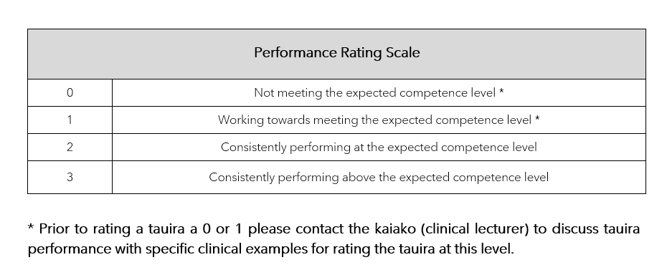
Each pou requires a rating and brief comment

Slide 12
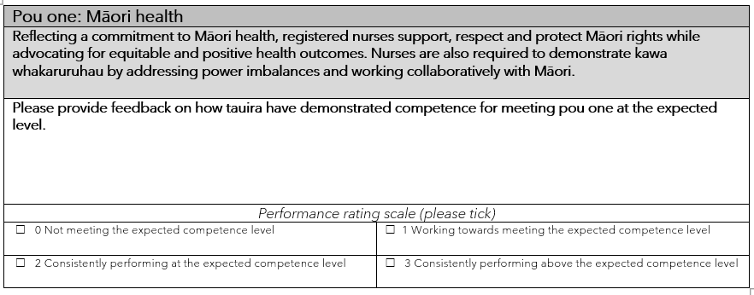

Slide 13
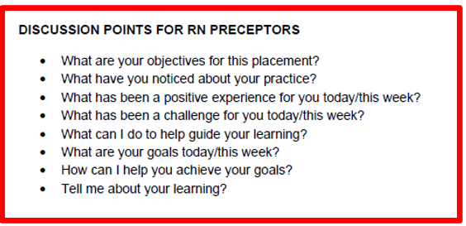
Discussion and debrief with tauira

Slide 14


How to support your student/new graduate…
Manaakitānga (hospitality and generosity)
Whanaungatānga (working together to provide a sense of belonging)
Kotahitānga (unity/solidarity)
Briefing/Debriefing 5-10 mins start of shift/end of shift – what went well today?
Help set daily/weekly goals
Any concerns – contact clinical lecturer EARLY
Portfolio work support
Process for ‘Record for Concern’

Slide 15
Support for RN/EN preceptor
Enrol in online preceptor Moodle course here
Te Whatu Ora Preceptor workshop
Otago Polytechnic School of Nursing
  Clinical Lecturer (contact details)
  Clinical Course Coordinator
  Programme Leader
Clinical Nurse Educator
Utilise NCNZ documents
  Guidelines: responsibilities for direction and delegation
  Code of conduct
  Professional responsibilities
  Nursing Council Standards of Competence

Slide 16

https://online.op.ac.nz/study/nursing/nursing-preceptors

Slide 17

This Photo by Unknown Author is licensed under CC BY

